Slide 1
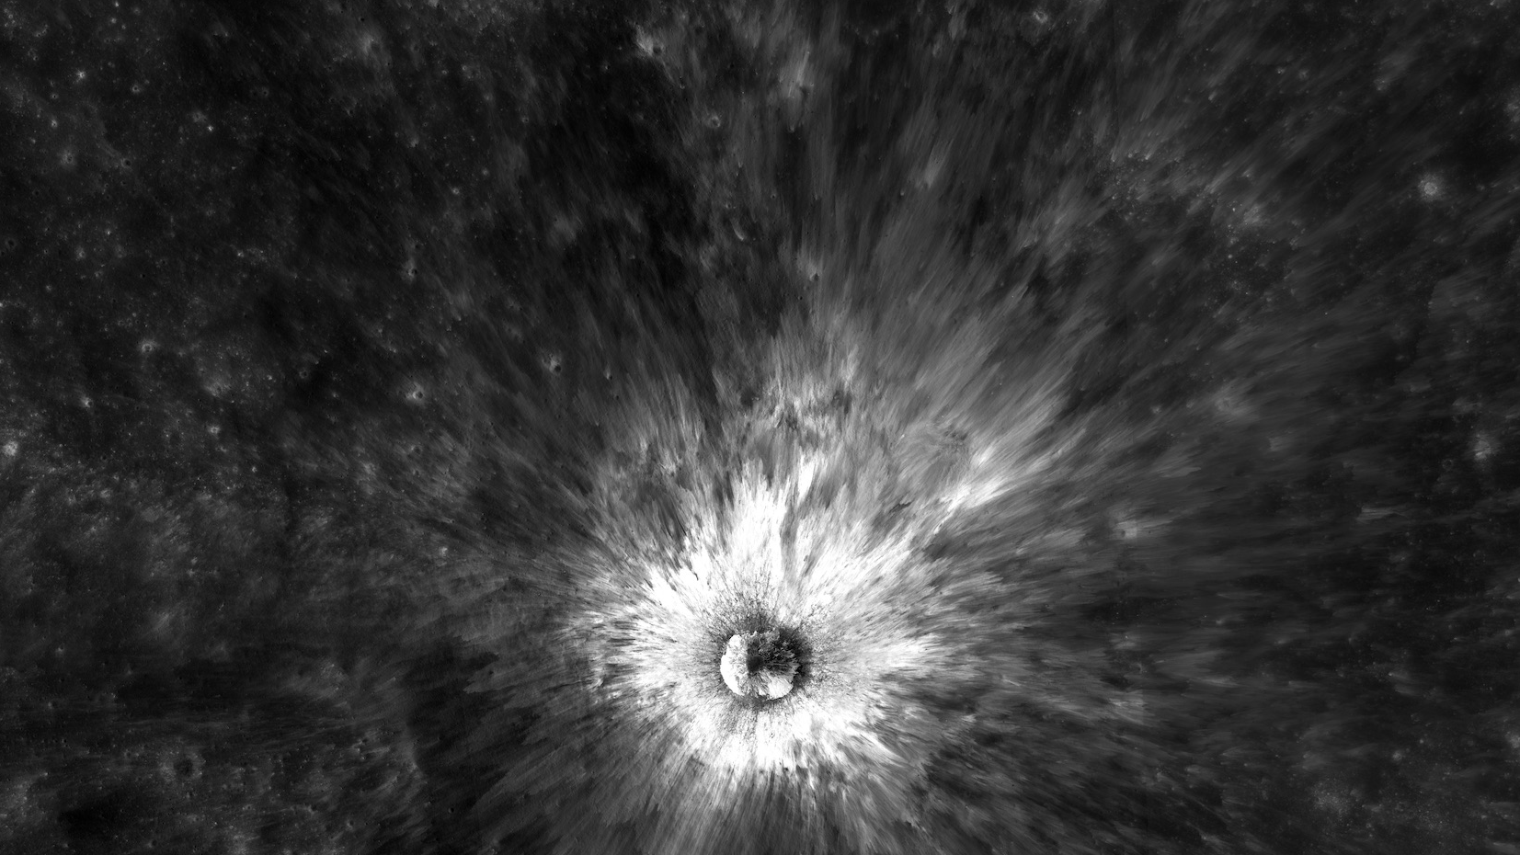
2021: A Moon in Review
Your Name
Your Title
Notes:
This slide deck provides an overview of some recent news as it relates to the Moon and looks at what’s ahead in lunar-related topics. A lot of developments occurred this year in Moon news, so this presentation is not a complete account and should be taken as a starting point to further exploration. Feel free to adapt the slides to your particular audience.
Image credit: NASA/GSFC/Arizona State University → https://moon.nasa.gov/resources/447/chaplygin-b-crater/

Slide 2

International Observe the Moon Night
Notes:
International Observe the Moon Night is a worldwide celebration of lunar science and exploration, celestial observation, and our cultural and personal connections to the Moon. Every autumn, we invite everyone on Earth to observe, learn about, and celebrate the Moon together. People participate in a variety of ways, including hosting or attending virtual or in-person events and observing the Moon from home. Participants also connect online with fellow lunar enthusiasts around the world through our social media platforms.
Learn more and register on our website: https://moon.nasa.gov/observe

Slide 3
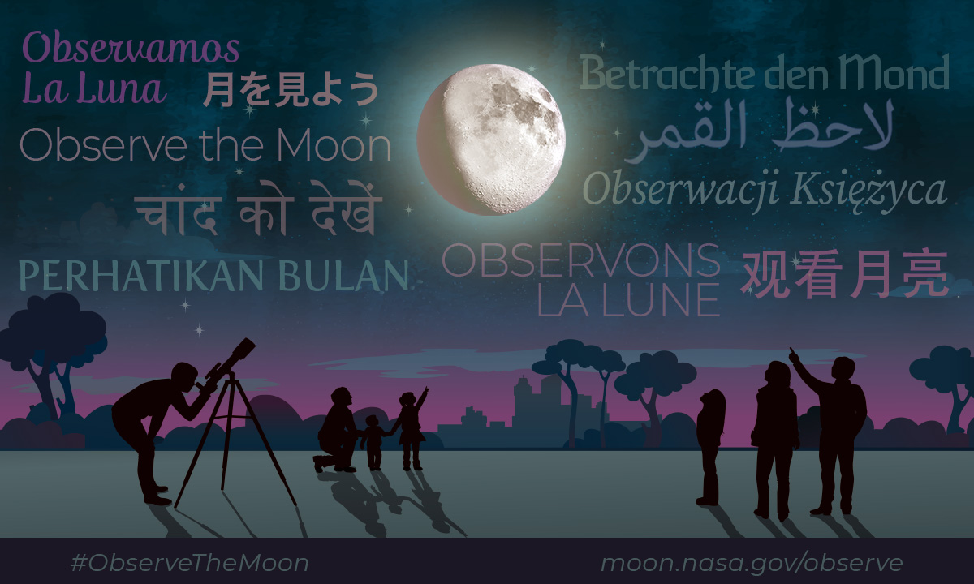
Multilanguage Graphic
Notes:
International Observe the Moon Night is a global event – people all around the world are invited to share in a celebration of lunar observation, science, and exploration.
Graphic source: https://moon.nasa.gov/resources/461/celebrate-international-observe-the-moon-night/

Slide 4
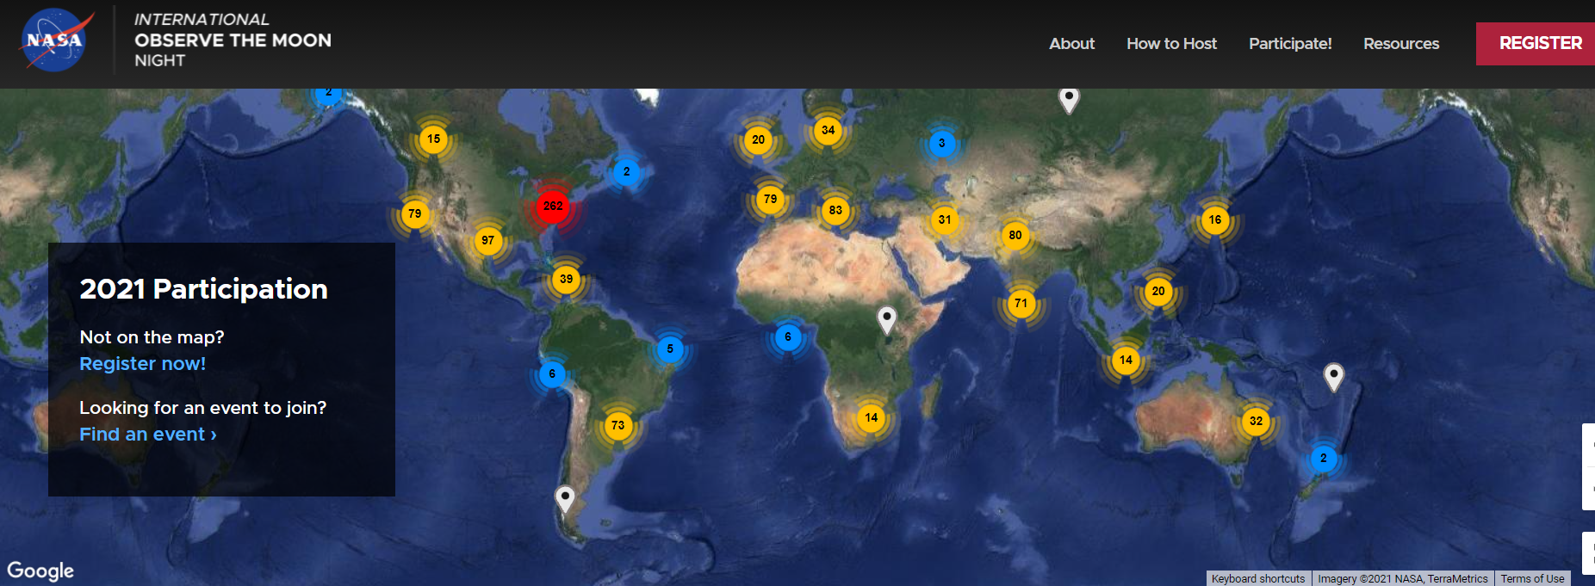
Events registered as of October 7
Notes:
There are multiple entryways into participating in International Observe the Moon Night. Our website contains a page dedicated to registration, where people can search for events that are already planned (both in-person and virtual), register their own events, or sign up as individual lunar observers. Events can be scheduled anytime in the two-week period surrounding the main International Observe the Moon Night date in order to better accommodate event hosts and participants.
Register and get yourself on the map!: https://moon.nasa.gov/observe-the-moon-night/register/private-event/

Slide 5
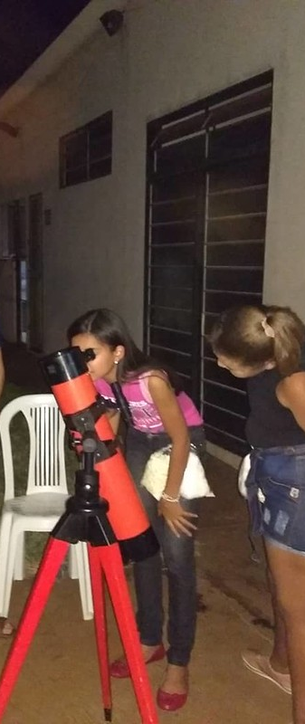
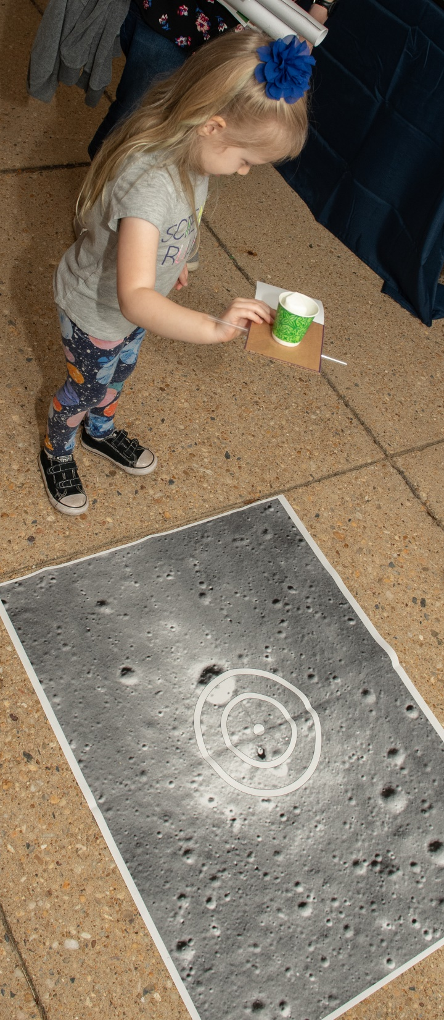
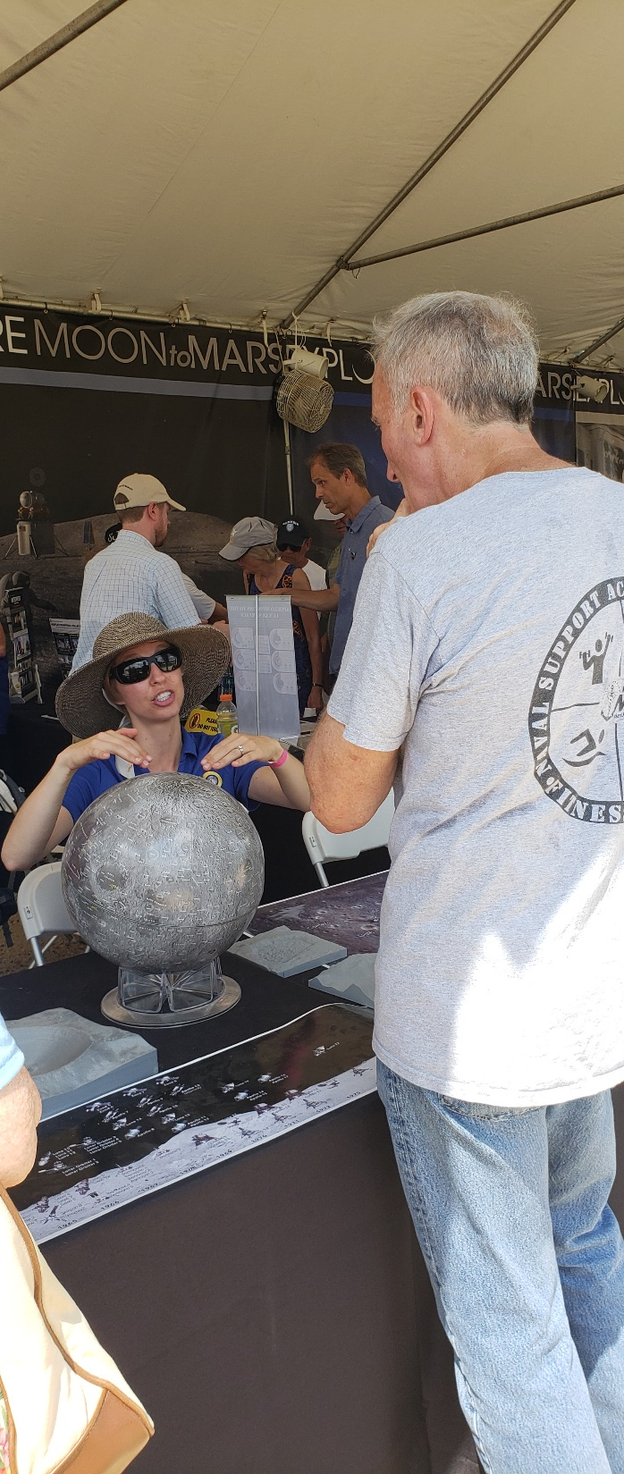
So Many Ways to Observe the Moon
#ObserveTheMoon
José Carlos Salerno
NASA
NASA/LRO/ASU
NASA
Notes:
There are also numerous ways that people can observe and celebrate the Moon. We encourage broad interpretation; looking at the Moon through telescopes or binoculars or the unaided eye, observing the Moon through art or writings, or “tasting the Moon” via cookie lunar models are just a few examples. Regardless of whether you are participating in-person or virtually, there is an opportunity to take and make this your own. Everyone contributes differently.

Slide 6
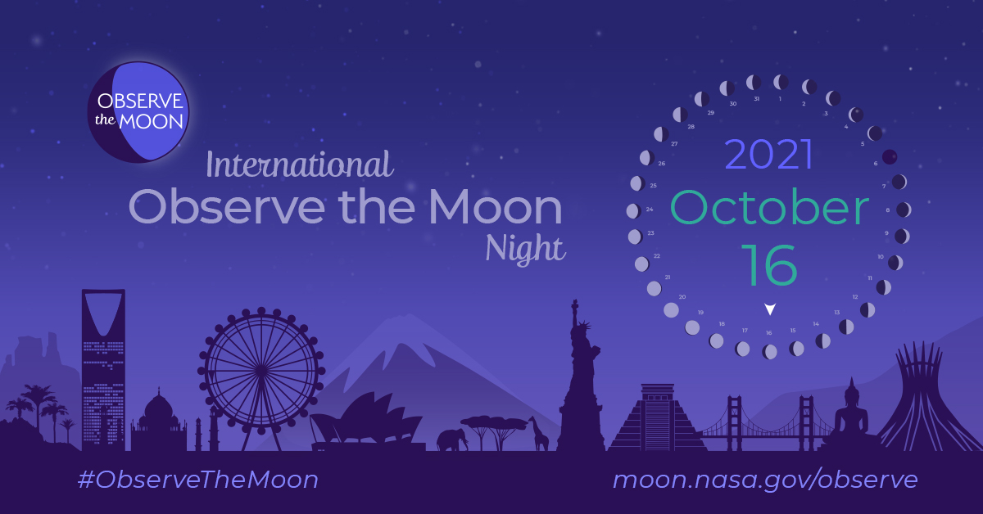


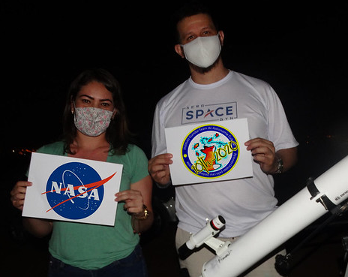

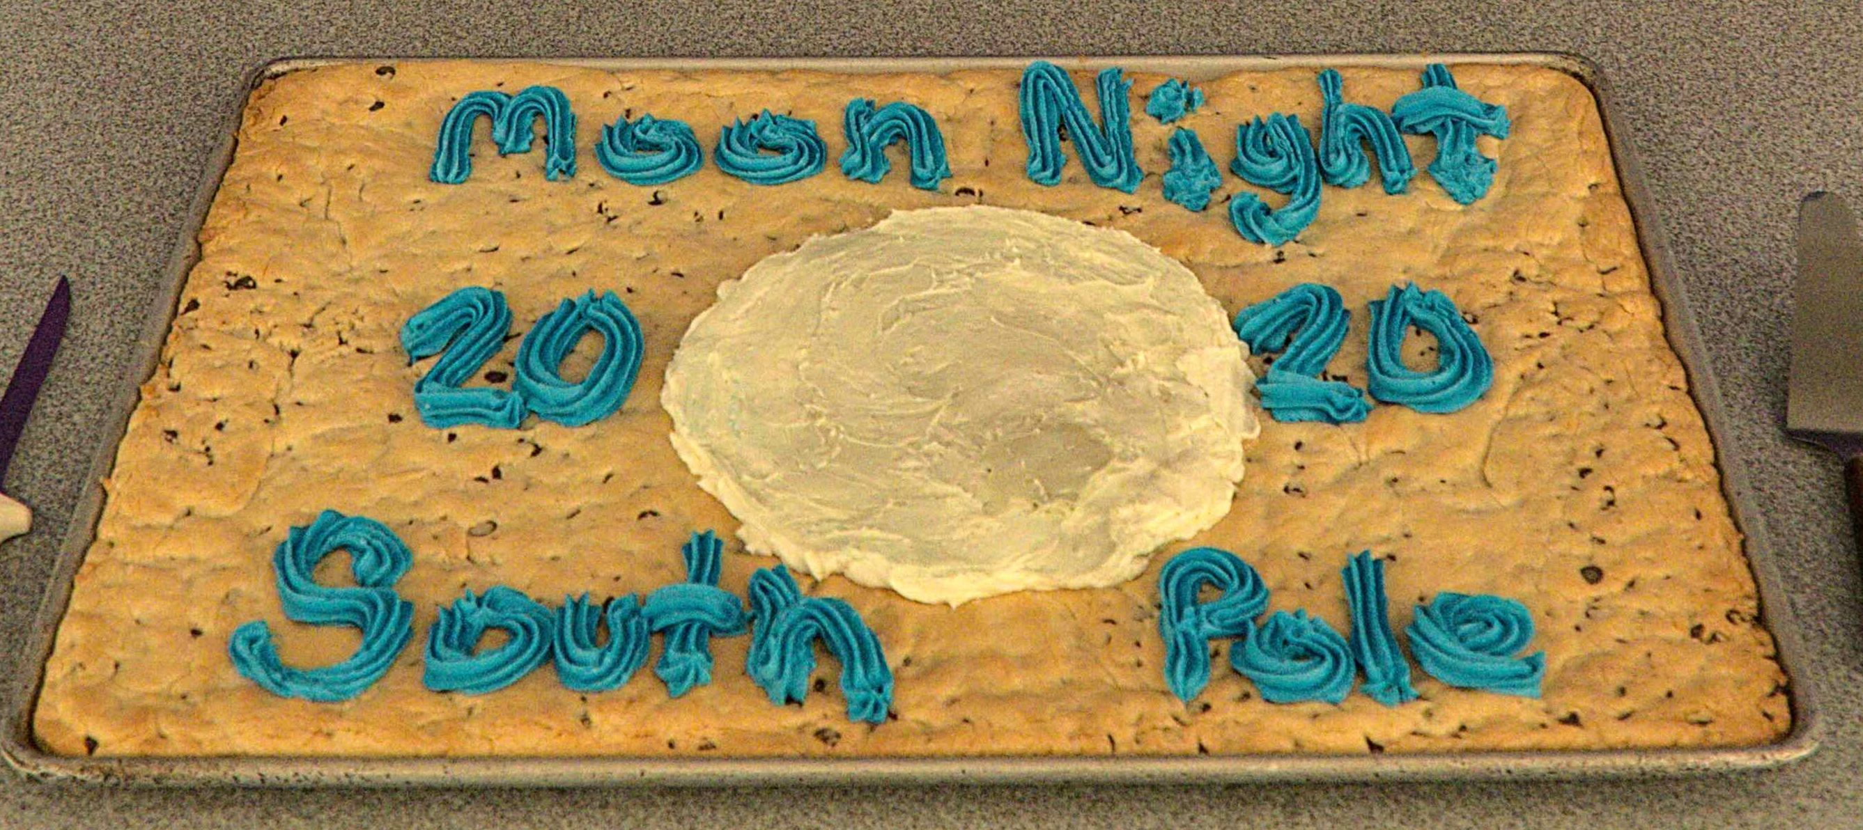
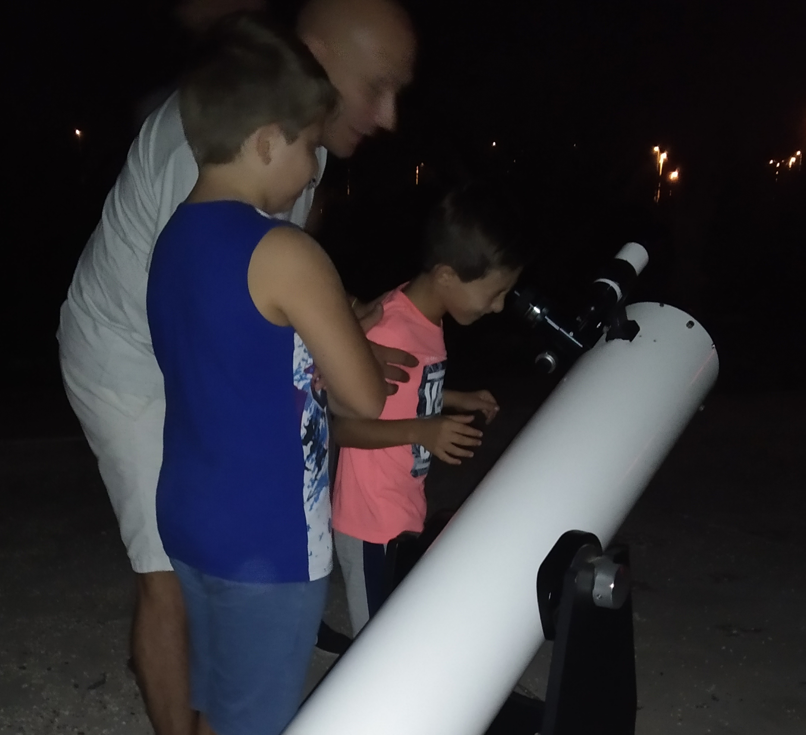
Example Participation Images
Linda McKenna
Joaquin Zurdo
Gunstar Team
Gianluca Masi
Victoriano Canales Cerdá
Clube de Astronomia
Zach Tejral

Slide 7
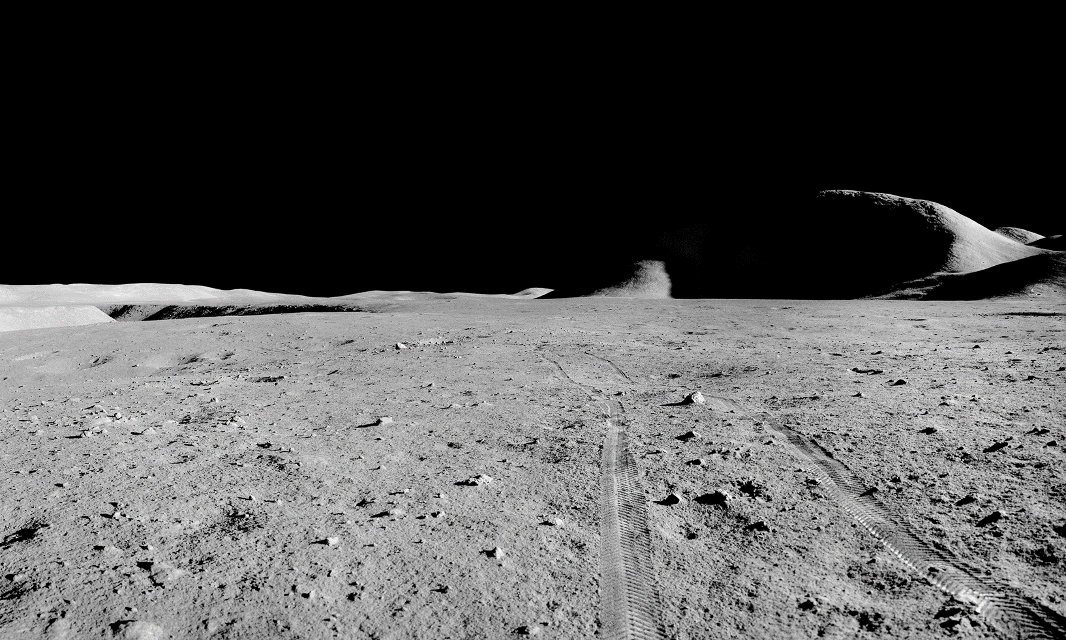
2021 Moon Highlights
Notes:
-Image credit: NASA → A Station 1 pan from the first EVA of Apollo 15, showing Hadley Rille on the left and Mt. Hadley on the right.

Slide 8
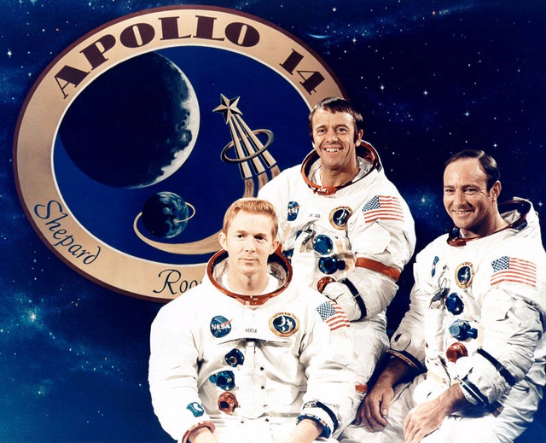
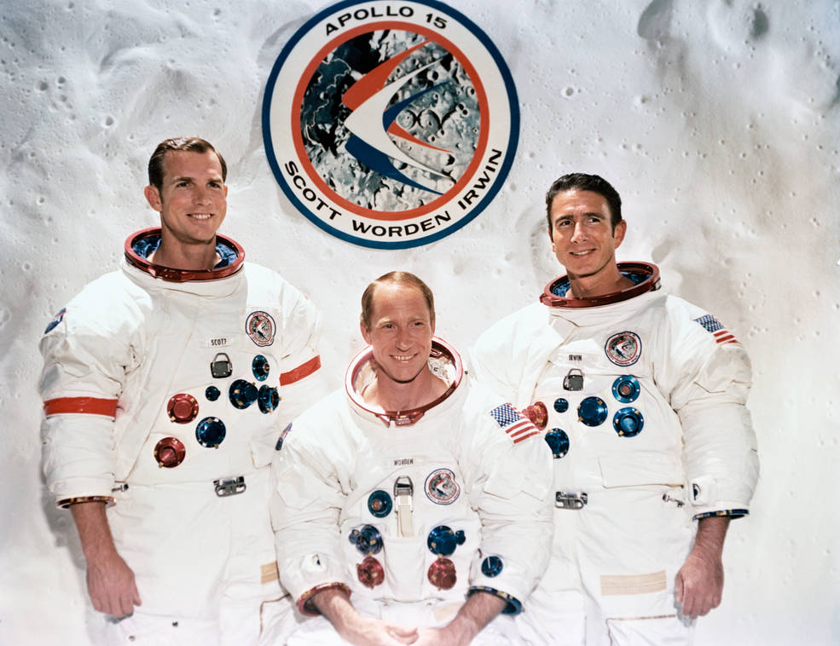
50th Anniversaries: Apollos 14 & 15
Jan. 31 - Feb. 9, 1971
July 26 - Aug. 7, 1971
Notes:
-Image credits: NASA
Left image: Apollo 14 crew. From left: Stuart Roosa (command module pilot), Alan Shepard Jr. (commander), and Edgar Mitchell (lunar module pilot).
Right image: Apollo 15 crew. From left: David Scott (commander), Alfred Worden (command module pilot), and James Irwin (lunar module pilot).
-2021 marked the 50th anniversaries of two Apollo missions to the Moon: Apollo 14 and Apollo 15.
-Apollo 14:
Third human Moon landing – Al Shepard and Ed Mitchell set foot on the lunar surface on February 5, 1971, almost ten months after Apollo 13’s intended landing date.
The mission plan for Apollo 14 had several objectives for the crew to accomplish: investigate the lunar surface near a preselected point in the Fra Mauro formation (Apollo 13’s intended landing site), deploy and activate an Apollo Lunar Surface Experiments Package (ALSEP), further develop the ability to work in the lunar environment, and obtain photographs of candidate exploration sites.
Highlights: Al Shepard hit two golf balls on the Moon at the end of the last extravehicular activity while Ed Mitchell threw a lunar “javelin”; Stuart Roosa brought hundreds of tree seeds with him to the Moon, and many are now growing on Earth; the Modular Equipment Transporter (MET), used on this mission for the first time, assisted the crew in carrying equipment and lunar samples.
-Apollo 15:
Fourth human Moon landing – Dave Scott and Jim Irwin landed on the lunar surface on July 30, 1971 at 6:16pm EST, with the first extravehicular activity beginning on July 31 at 9:13am EST.
Apollo 15 was the first of the so-called J missions, which considerably expanded the capabilities for doing science on and near the Moon.
For the first time, three 7-hour-long EVAs would be performed, and a lunar rover would significantly extend the distance a crew could travel over the lunar surface. In addition, the restriction on landing near the equator was lifted. Finally, a sophisticated suite of science experiments was also carried in the service module and used to map the Moon from orbit.
Highlights: Apollo 15 saw the first flight of the Lunar Roving Vehicle (LRV) which enabled total surface traverses to increase from hundreds of meters during earlier missions to tens of kilometers during Apollo 15 and 16 and just over 100 km during Apollo 17; Dave Scott demonstrated Galileo’s discovery about falling objects in gravity fields when he simultaneously dropped a feather and a hammer, and they both hit the ground at the same time; Al Worden became the first human to carry out a deep space spacewalk when he exited the command module to retrieve the 8,000 ft (2.4 km) of film contained in the cassettes from the service module.
-More info on Apollo 14: https://moon.nasa.gov/resources/414/apollo-14-presentation/
-More info on Apollo 15: https://moon.nasa.gov/resources/442/apollo-15-presentation/

Slide 9
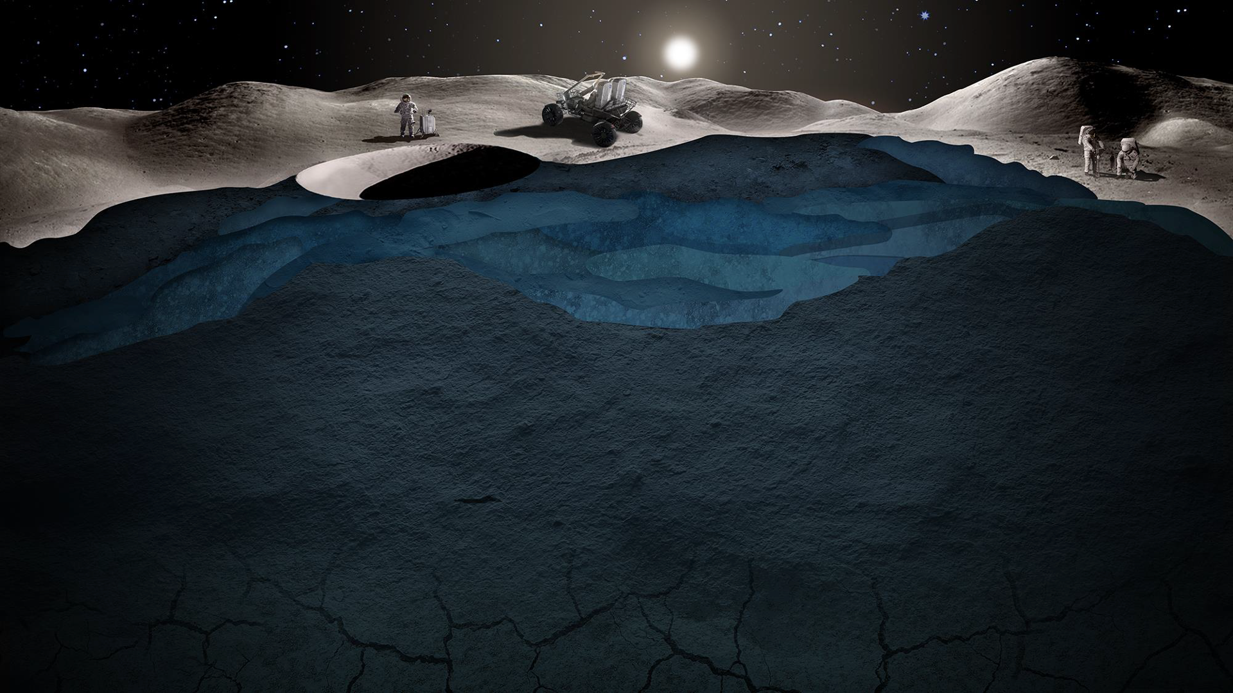
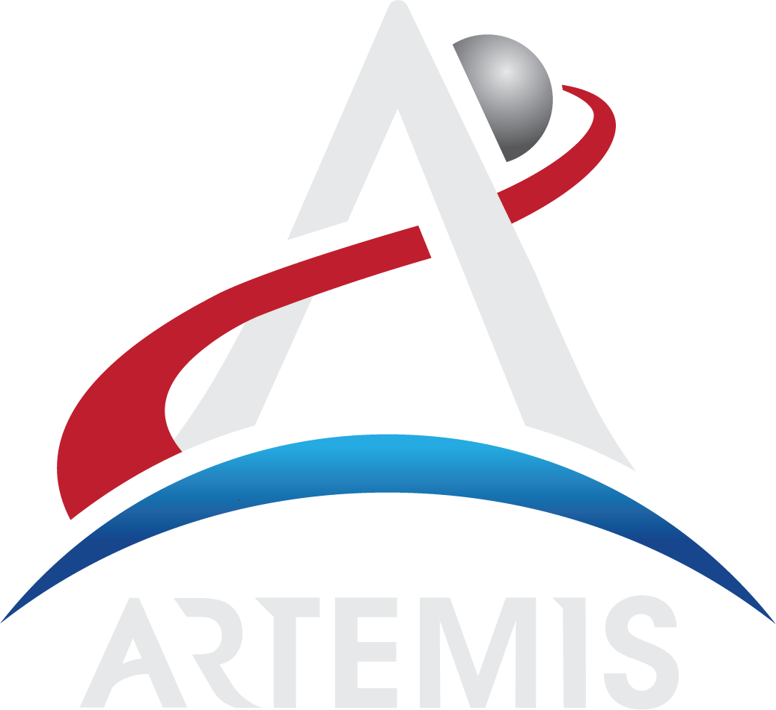
A New Era of Crewed Exploration
Notes:
-This is an especially exciting time for lunar science and exploration! NASA’s Artemis program plans to land the first woman and first person of color on the Moon within the coming years and features collaborations with commercial and international partners.
This will promote equity – signaling to people around the world that they too can see themselves among the stars.
-NASA’s Artemis missions also include sending a suite of new science instruments and technology demonstrations to study the Moon and establishing a long-term presence there.
-There have been a lot of developments in the Artemis program in 2021, so be sure to check out the NASA Artemis website for the full details: https://www.nasa.gov/artemisprogram.
One particular update is the naming of the manikin launching on Artemis I, NASA’s uncrewed flight test of the Space Launch System (SLS) rocket and Orion spacecraft around the Moon later this year or early next year. “Commander Moonikin Campos” is the official name of the Artemis I manikin.
The name Campos is a dedication to Arturo Campos, a key player in bringing Apollo 13 safely back to Earth.
-More on the Artemis I ‘Moonikin’: https://www.nasa.gov/press-release/public-names-moonikin-flying-around-moon-on-nasa-s-artemis-i-mission

Slide 10
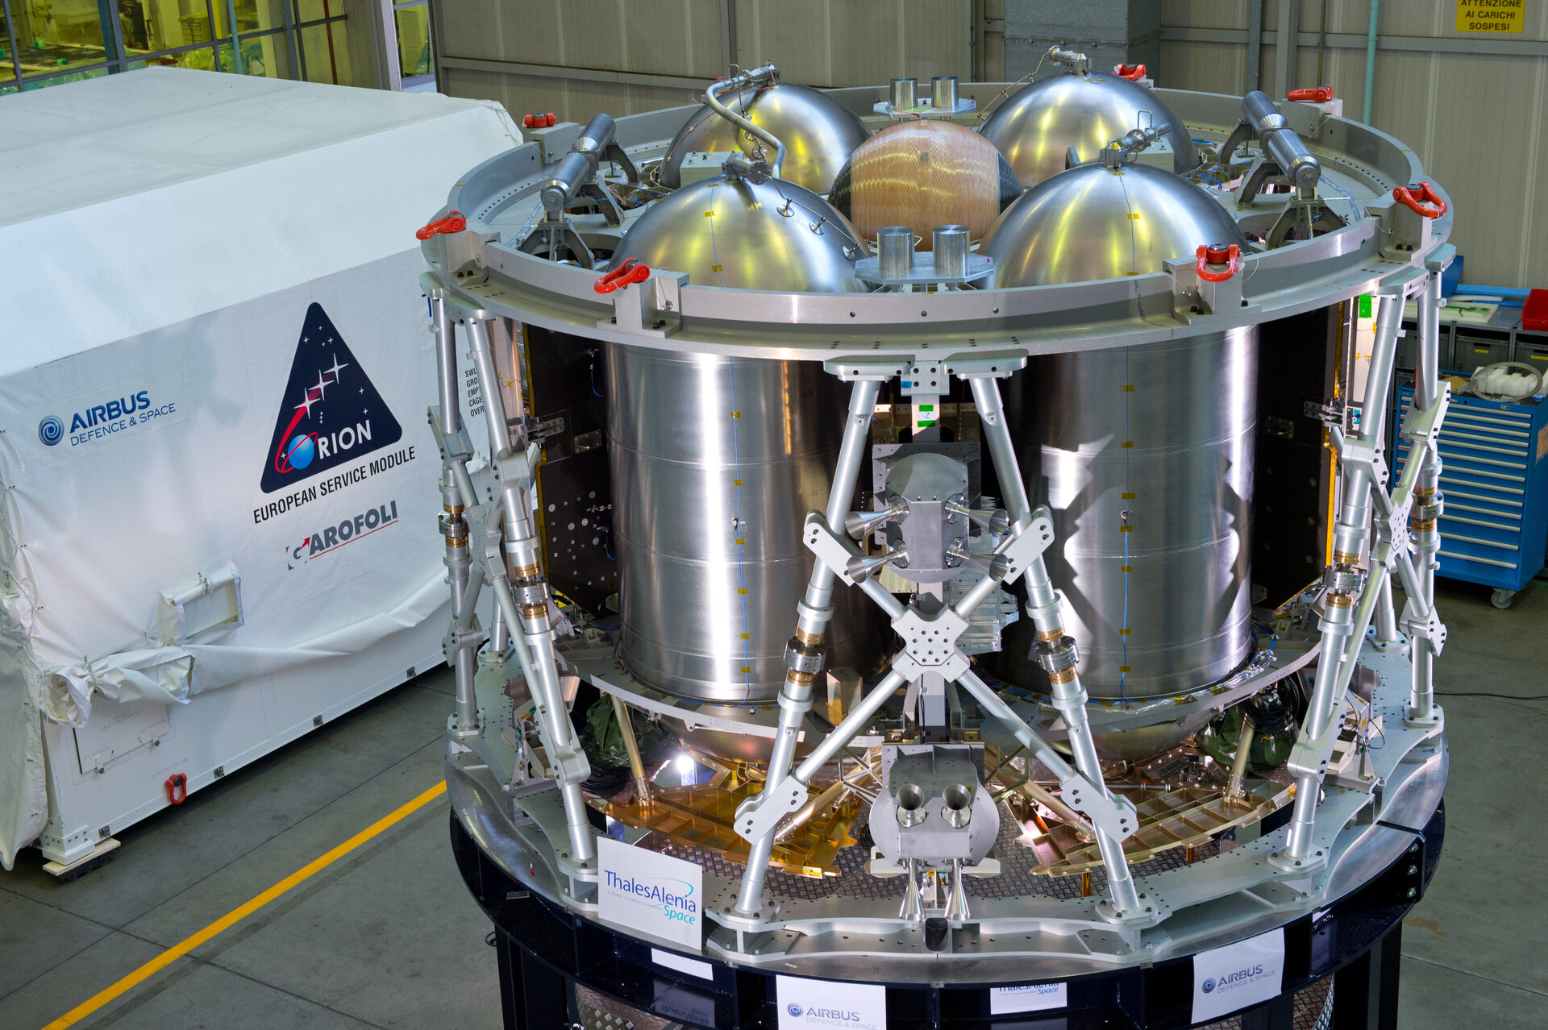
European Space Agency & Artemis
Airbus
Notes:
-Image credit: Airbus → A test version of ESA’s European Service Module for NASA’s Orion spacecraft at Thales Alenia Space in Turin, Italy, before shipping to the U.S.
-There have also been many developments to the Artemis program in the international realm.
-One of these updates is the following from the European Space Agency (ESA):
ESA is contributing to humankind’s return to the Moon with its European Service Modules that will be incorporated into upcoming Artemis missions.
NASA will be launching Artemis I from Kennedy Space Center in Florida later this year or in early 2022. This uncrewed mission will carry NASA’s Orion spacecraft incorporating ESA’s European Service Module (ESM-1), built and tested by Airbus Bremen, in Germany, with the help of 10 European nations.
ESM-1’s main engine and 32 thrusters will propel Orion into orbit around the Moon and return it to Earth.
ESA’s work also continues on European Service Module (ESM-2) and ESM-3.
-More info: https://www.esa.int/Science_Exploration/Human_and_Robotic_Exploration/Orion/European_Service_Module
-European Push to the Moon video: https://www.youtube.com/watch?v=fXtsi_pKGTc

Slide 11
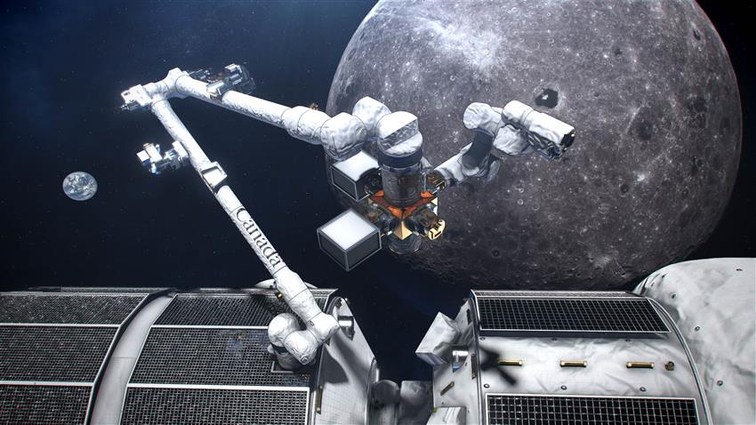
Canadian Space Agency & Artemis
Canadian Space Agency, NASA
Notes:
-Image credit: Canadian Space Agency, NASA → An artist’s concept of Canadarm3, Canada’s smart robotic system, located on the exterior of the Gateway, a small space station planned to be in orbit around the Moon.
-Another international development for the Artemis program comes from the Canadian Space Agency (CSA).
Canadarm3 will be Canada’s contribution to NASA’s Gateway, a vital component of Artemis, that will serve as a multi-purpose outpost orbiting the Moon that provides essential support for long-term human return to the lunar surface and serves as a staging point for deep space exploration.
Canadarm3’s highly autonomous robotic system will use cutting-edge software to perform tasks around the Moon without the need for human intervention.
The next-generation Canadian robotic system will be designed to:
Maintain, repair and inspect the Gateway
Capture visiting vehicles
Relocate Gateway modules
Help astronauts during spacewalks
Enable science both in lunar orbit and on the surface of the Moon
-More info on Canadarm3: https://www.asc-csa.gc.ca/eng/canadarm3/about.asp
-More info on the Gateway: https://www.nasa.gov/gateway

Slide 12
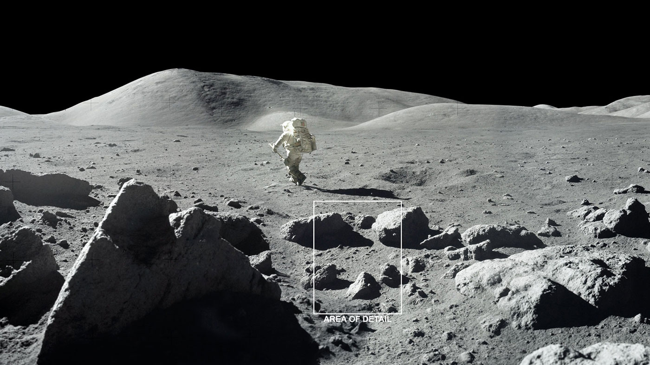
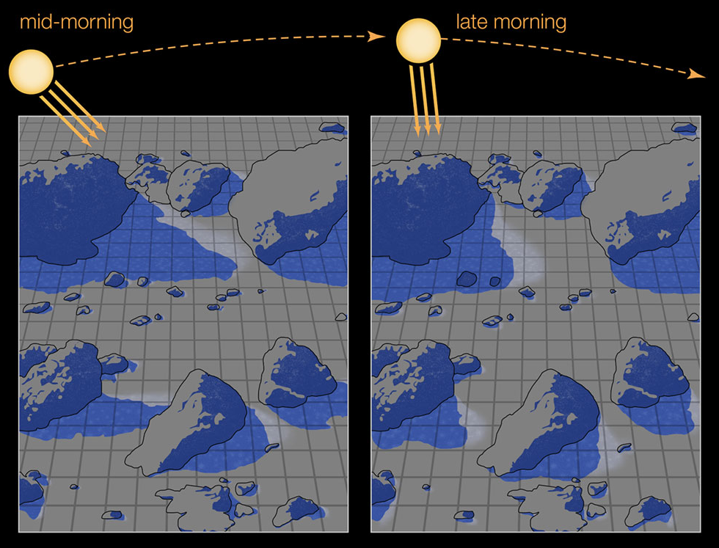
Water on the Moon
Notes:
-Image credits:
Background: NASA → The Moon is covered with craters and rocks, creating a surface “roughness” that casts shadows, as seen in this photograph from the 1972 Apollo 17 mission. These cold shadows may allow water ice to accumulate as frost even at daytime. The area of detail is highlighted in the image overlay.
Overlay: NASA/JPL-Caltech → This illustration zooms in on the area of detail, showing how shadows enable water ice to survive on the sunlit lunar surface. When shadows move as the Sun tracks overhead, the exposed frost lingers long enough to be detected by spacecraft.
-We’ve long known that water exists in some of the Moon’s dark craters, but the 2020 discovery of water on daylit parts of the Moon presented a puzzle: previous computer models suggested any water ice that forms during the lunar night should quickly burn off as the Sun climbs overhead.
NASA JPL scientists have an explanation: shadows created by the “roughness” of the lunar surface provide refuge for water ice, enabling it to form as surface frost far from the Moon’s poles. This frost is then detected by spacecraft.
-Understanding water as a resource is essential for future human lunar exploration. If water is available in the form of frost in sunlit regions of the Moon, future Artemis explorers may use it as a resource for fuel and drinking water.
-More info: https://www.nasa.gov/feature/jpl/nasa-study-highlights-importance-of-surface-shadows-in-moon-water-puzzle
-Supplementary info: https://www.nasa.gov/press-release/nasa-s-sofia-discovers-water-on-sunlit-surface-of-moon

Slide 13
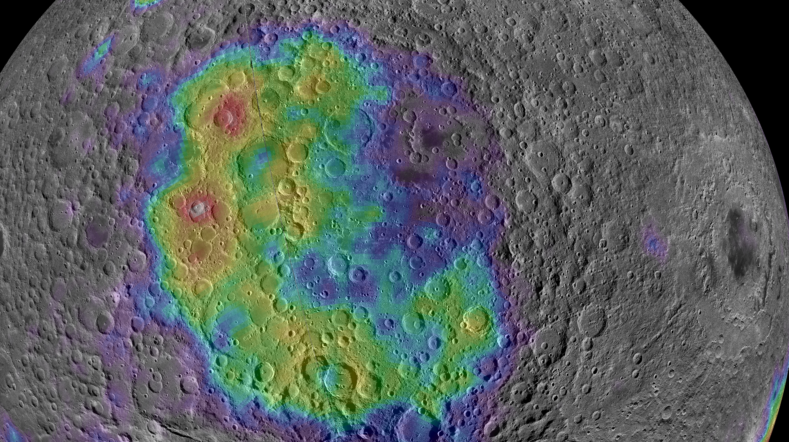
Likely Locations of Early Molten Moon's Deep Secrets
NASA/LRO/Lunar Prospector/D. Moriarty
Notes:
-Image credit: NASA/LRO/Lunar Prospector/D. Moriarty → The thorium concentration across the vast South Pole – Aitken Basin on the lunar farside reveals the distribution of mantle materials violently ejected during the basin-forming impact.
Here, thorium abundance is represented by a rainbow color scale, with high-thorium areas shown in red, trending to purple and grey with lower abundances.
Two craters in the northwestern region of the basin exhibit especially high thorium abundance (indicated in red on the map), suggesting the presence of abundant mantle materials currently exposed on the surface.
-The Lunar Reconnaissance Orbiter (LRO) is NASA’s flagship mission at the Moon, and it’s been orbiting the Moon for over 10 years! LRO is building on the legacy of Apollo, reshaping our understanding of our nearest neighbor in space – revealing an unexpectedly dynamic world right beside our own. And, it’s helping us prepare for the next phase in human exploration of the Moon through the Artemis program.
-Using data from LRO, Lunar Prospector, and the Moon Mineralogy Mapper instrument on board India’s Chandrayaan-I spacecraft, scientists have identified likely locations for NASA’s Artemis missions to find and collect pieces of the Moon’s mantle.
-For years, scientists have been puzzled by a radioactive anomaly in the northwest quadrant of the South Pole – Aitken Basin on the lunar far side. The team’s analysis demonstrates that the composition of this anomaly is consistent with the “sludge” that forms in the uppermost mantle at the very end of magma ocean crystallization. Because this sludge is very dense, scientists have previously assumed that it should completely sink into the lower mantle early in lunar history.
But, recent models and experiments indicate that some of this sludge gets trapped in the upper mantle, and later excavated by this vast impact basin. So, this northwest region of the South Pole – Aitken Basin is the best location to access excavated mantle materials currently on the lunar surface.
-The precious rocks born deep within the Moon can help us understand how our Moon and other rocky worlds evolved.
-More info: https://www.nasa.gov/feature/goddard/2021/lro-deep-secrets-of-moon

Slide 14
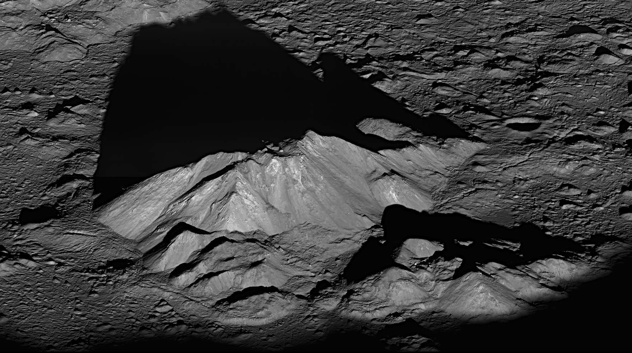
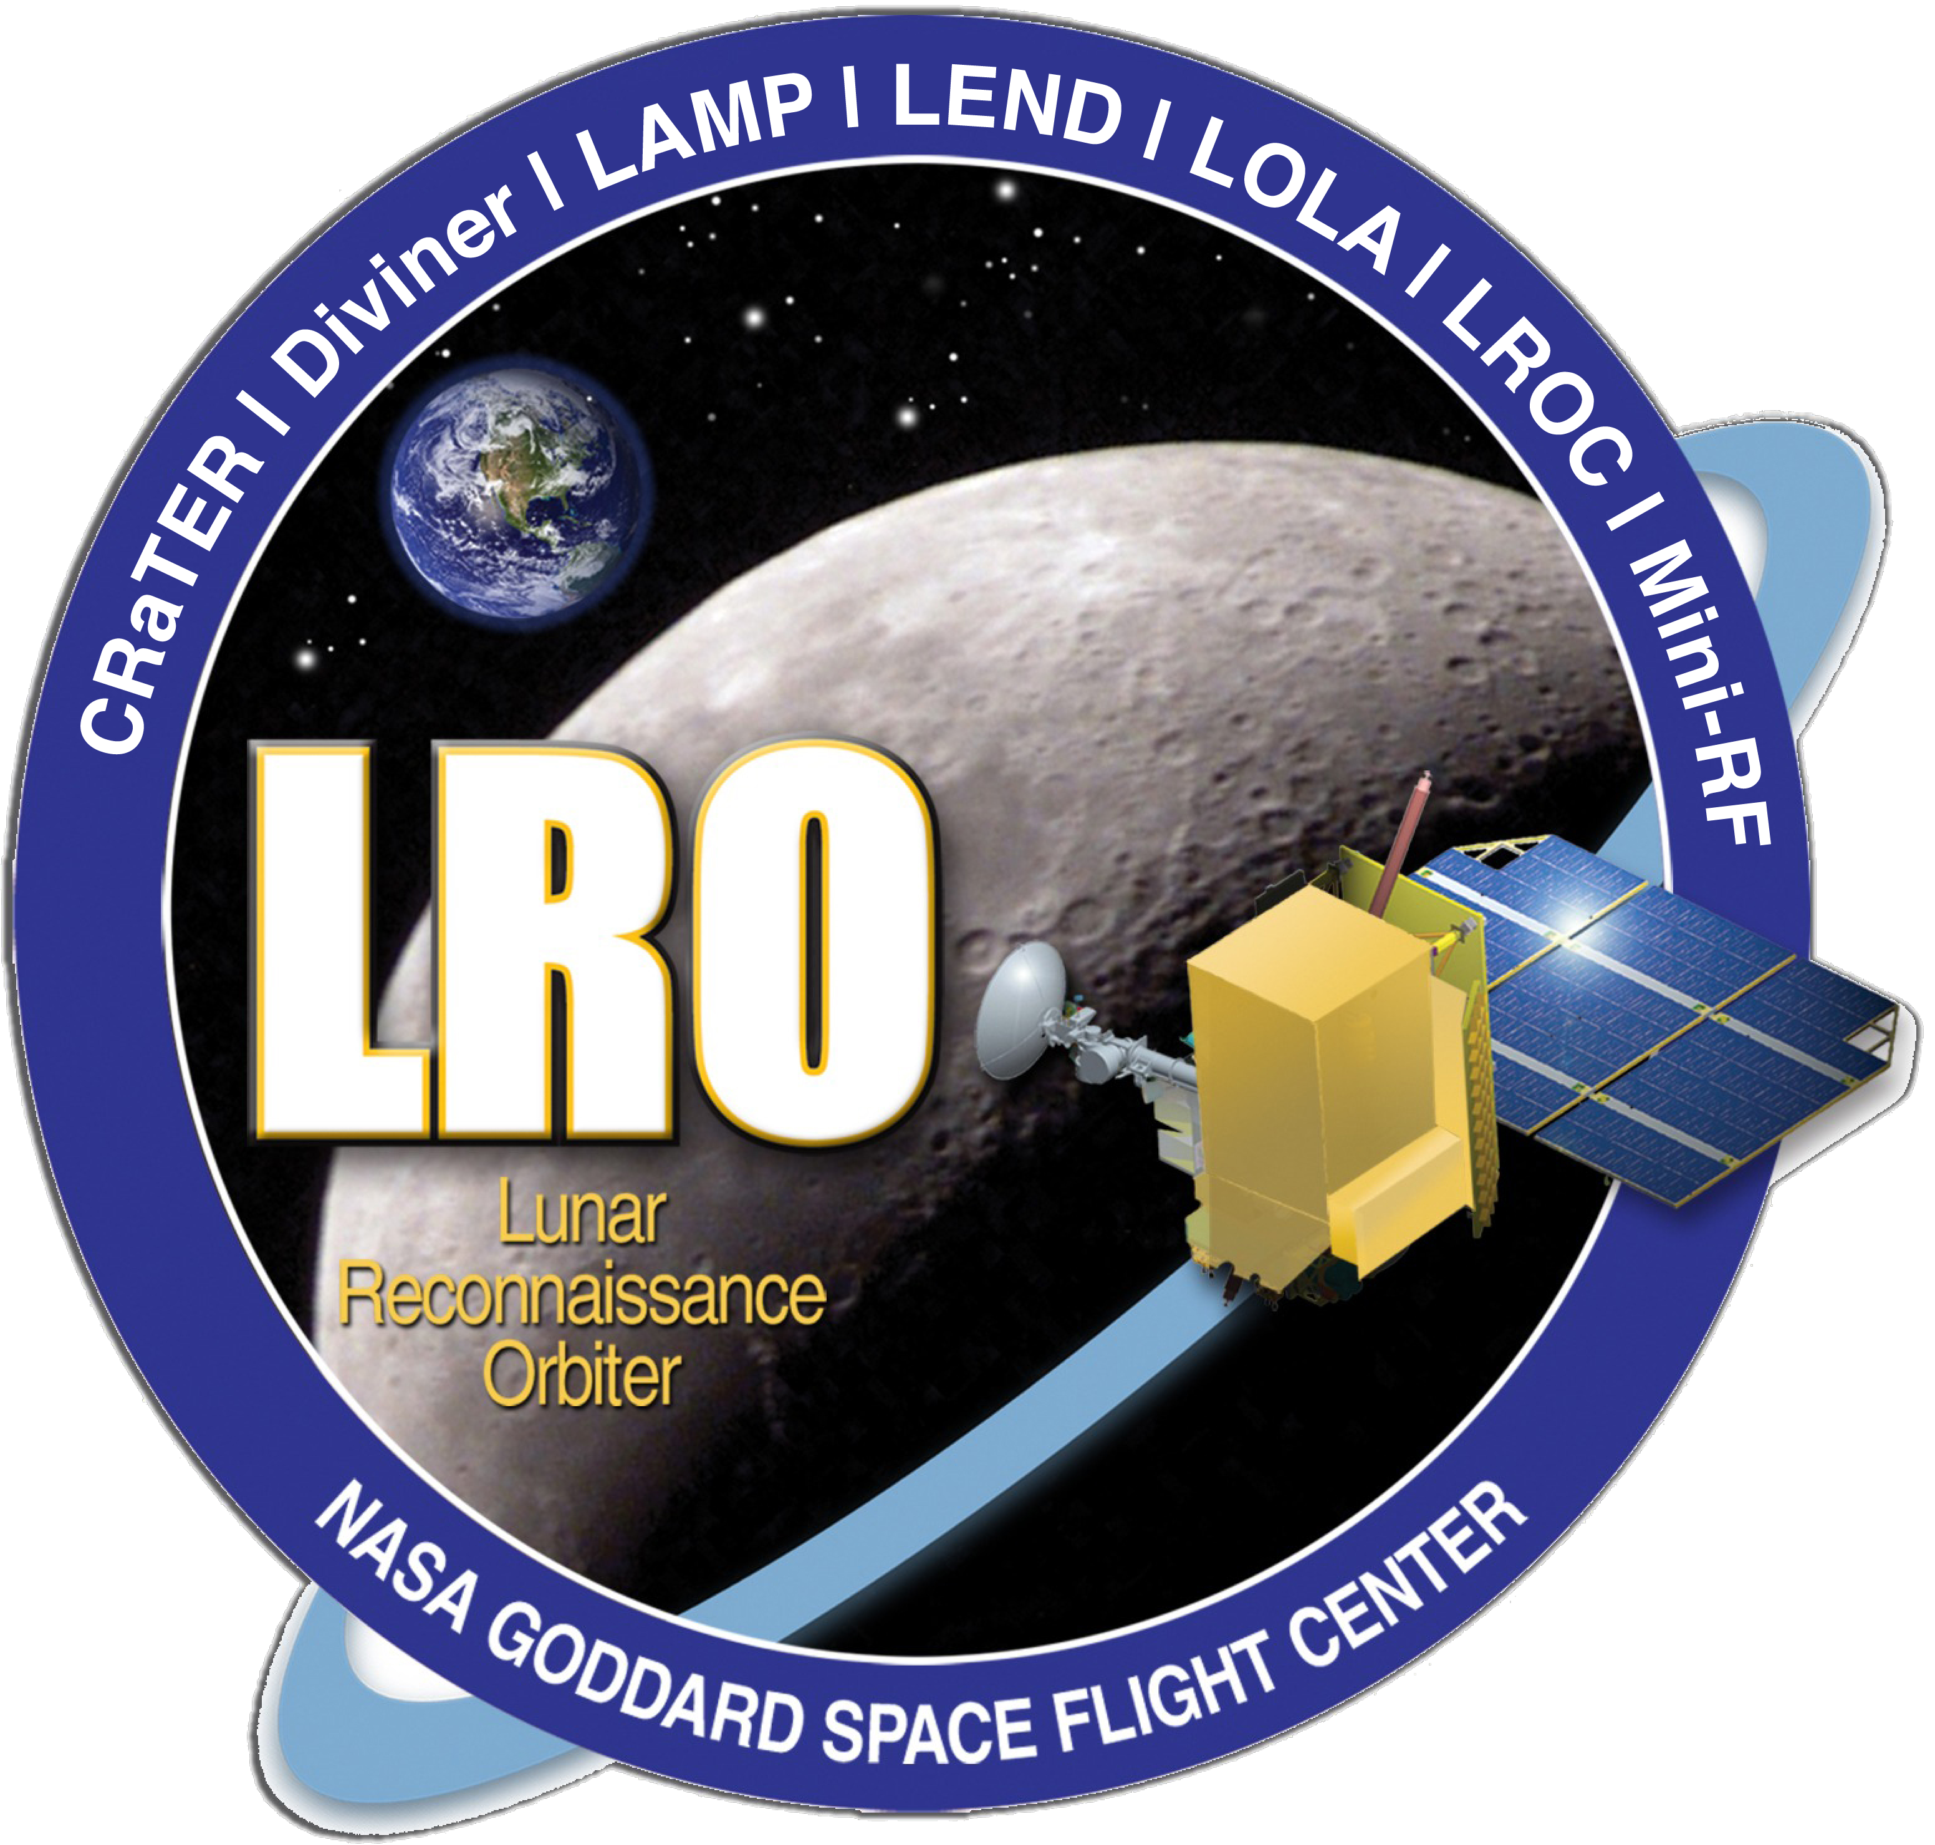
Teaching an Old Spacecraft New Tricks
NASA/GSFC/Arizona State University
Notes:
-Image credit: NASA/GSFC/Arizona State University → http://lroc.sese.asu.edu/posts/384
-In the spring of 2018, the Lunar Reconnaissance Orbiter’s Miniature Inertial Measurement Unit (MIMU), a critical sensor used to help point the spacecraft’s instruments, was powered off to preserve its remaining life after exhibiting signs of decline due to natural aging in the harsh environment of space.
The MIMU is like a speedometer. It measures LRO’s speed of rotation. Without it, LRO was forced to rely only on data from star trackers - video cameras with image processing software that infers orientation based on star maps - to point and reorient the spacecraft. This limited the ability to reorient (slew) the spacecraft for science purposes.
To get LRO slewing again, NASA engineers developed a new algorithm that can estimate LRO’s speed of rotation by fusing star-tracker measurements together with other information available from LRO’s flight computer.
The algorithm developed for LRO is called Fast Maneuvering or ‘FastMan’, and it works in conjunction with LRO’s star-tracker-based controller. The maneuvers naturally steer around bright objects just like obstacle avoidance in a self-driving car.
A computer algorithm is a set of instructions to process data. FastMan was constructed by using software tools that are based on the same tools previously used by a NASA-Naval Postgraduate School team to reorient the International Space Station by combining forces from the space environment together with its gyroscopes rather than burning fuel by firing its thrusters. This “Zero Propellant Maneuver” is similar to a tacking maneuver used in sailing.
LRO undergoes frequent special slews as it orbits the Moon, and the ability to schedule these slews is constrained by the time it takes to perform them.
With these new algorithms, LRO is again able to rapidly look to the side, and the spacecraft is in good health, with all instruments still collecting data.
-More info: https://www.nasa.gov/feature/goddard/2021/lro-new-tricks

Slide 15
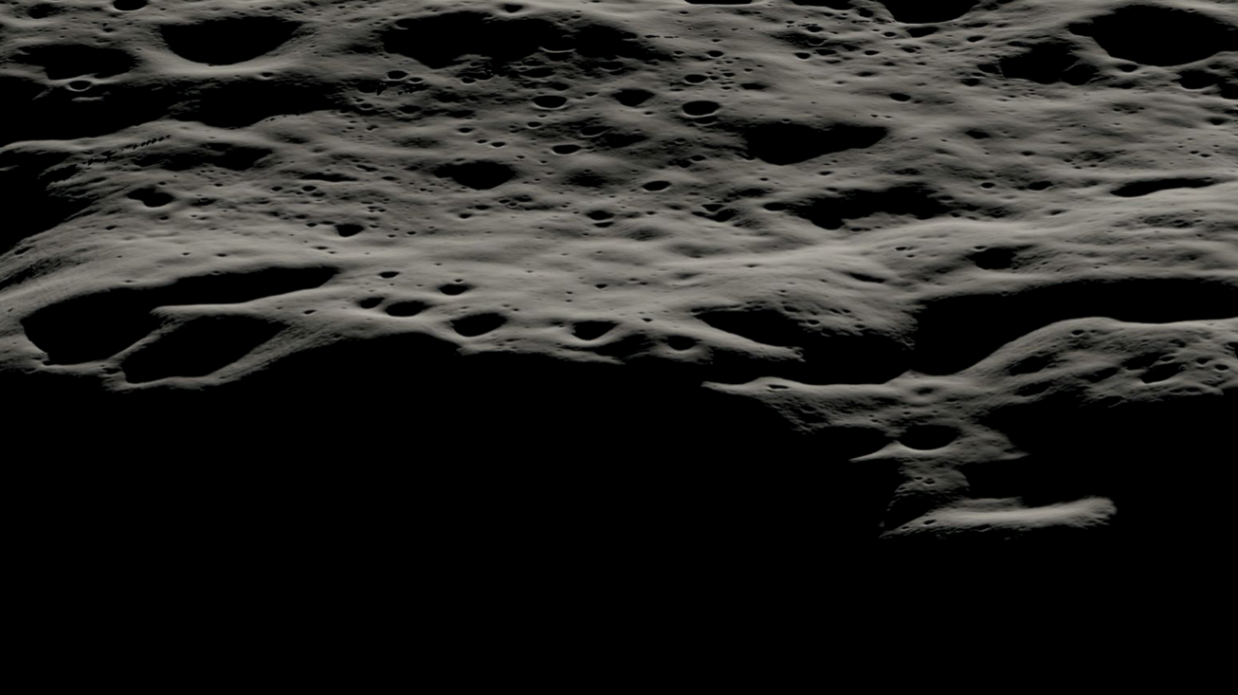
Looking Ahead
Notes:
-Image credit: NASA → A data visualization showing the mountainous area west of Nobile crater and the smaller craters that litter its rim at the lunar South Pole.

Slide 16
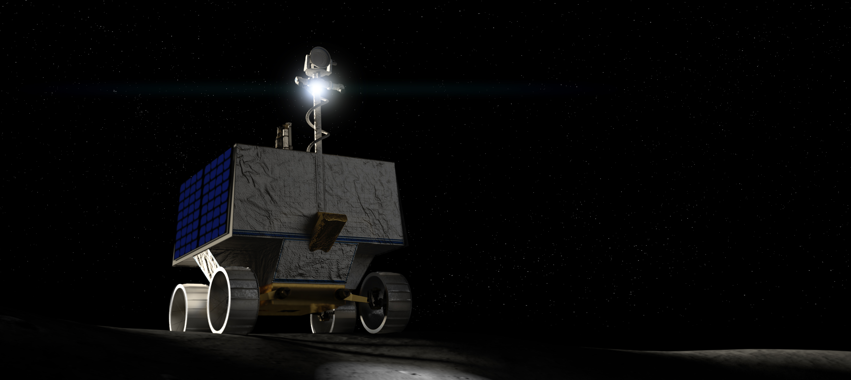
NASA’s Commercial Lunar Payload Services (CLPS) Initiative
Notes:
-NASA’s Commercial Lunar Payload Services (CLPS) initiative enables the quick acquisition of lunar delivery services from companies to bring an assortment of robotic payloads to the Moon’s surface. Investigations and demonstrations launched on commercial Moon flights will help NASA study Earth’s nearest neighbor under the Artemis program.
-The first CLPS instruments are planned for launch early next year.
-Some of these upcoming payloads are listed below:
2022:
Astrobotic will carry 11 payloads to Lacus Mortis, a larger crater on the near side of the Moon.
Intuitive Machines will carry six payloads to Oceanus Procellarum, a scientifically intriguing dark spot on the Moon, in early 2022.
Intuitive Machines will also deliver the PRIME-1 drill to the Moon by December 2022.
2023:
Astrobotic will deliver NASA’s VIPER mission to the lunar South Pole in late 2023.
Firefly Aerospace will deliver a suite of payloads to a non-polar region of the Moon in 2023.
Masten Space Systems will deliver and operate eight payloads – with nine science and technology instruments – to the lunar South Pole in 2023.
-More info: https://www.nasa.gov/clps
-Image from: https://www.nasa.gov/viper

Slide 17
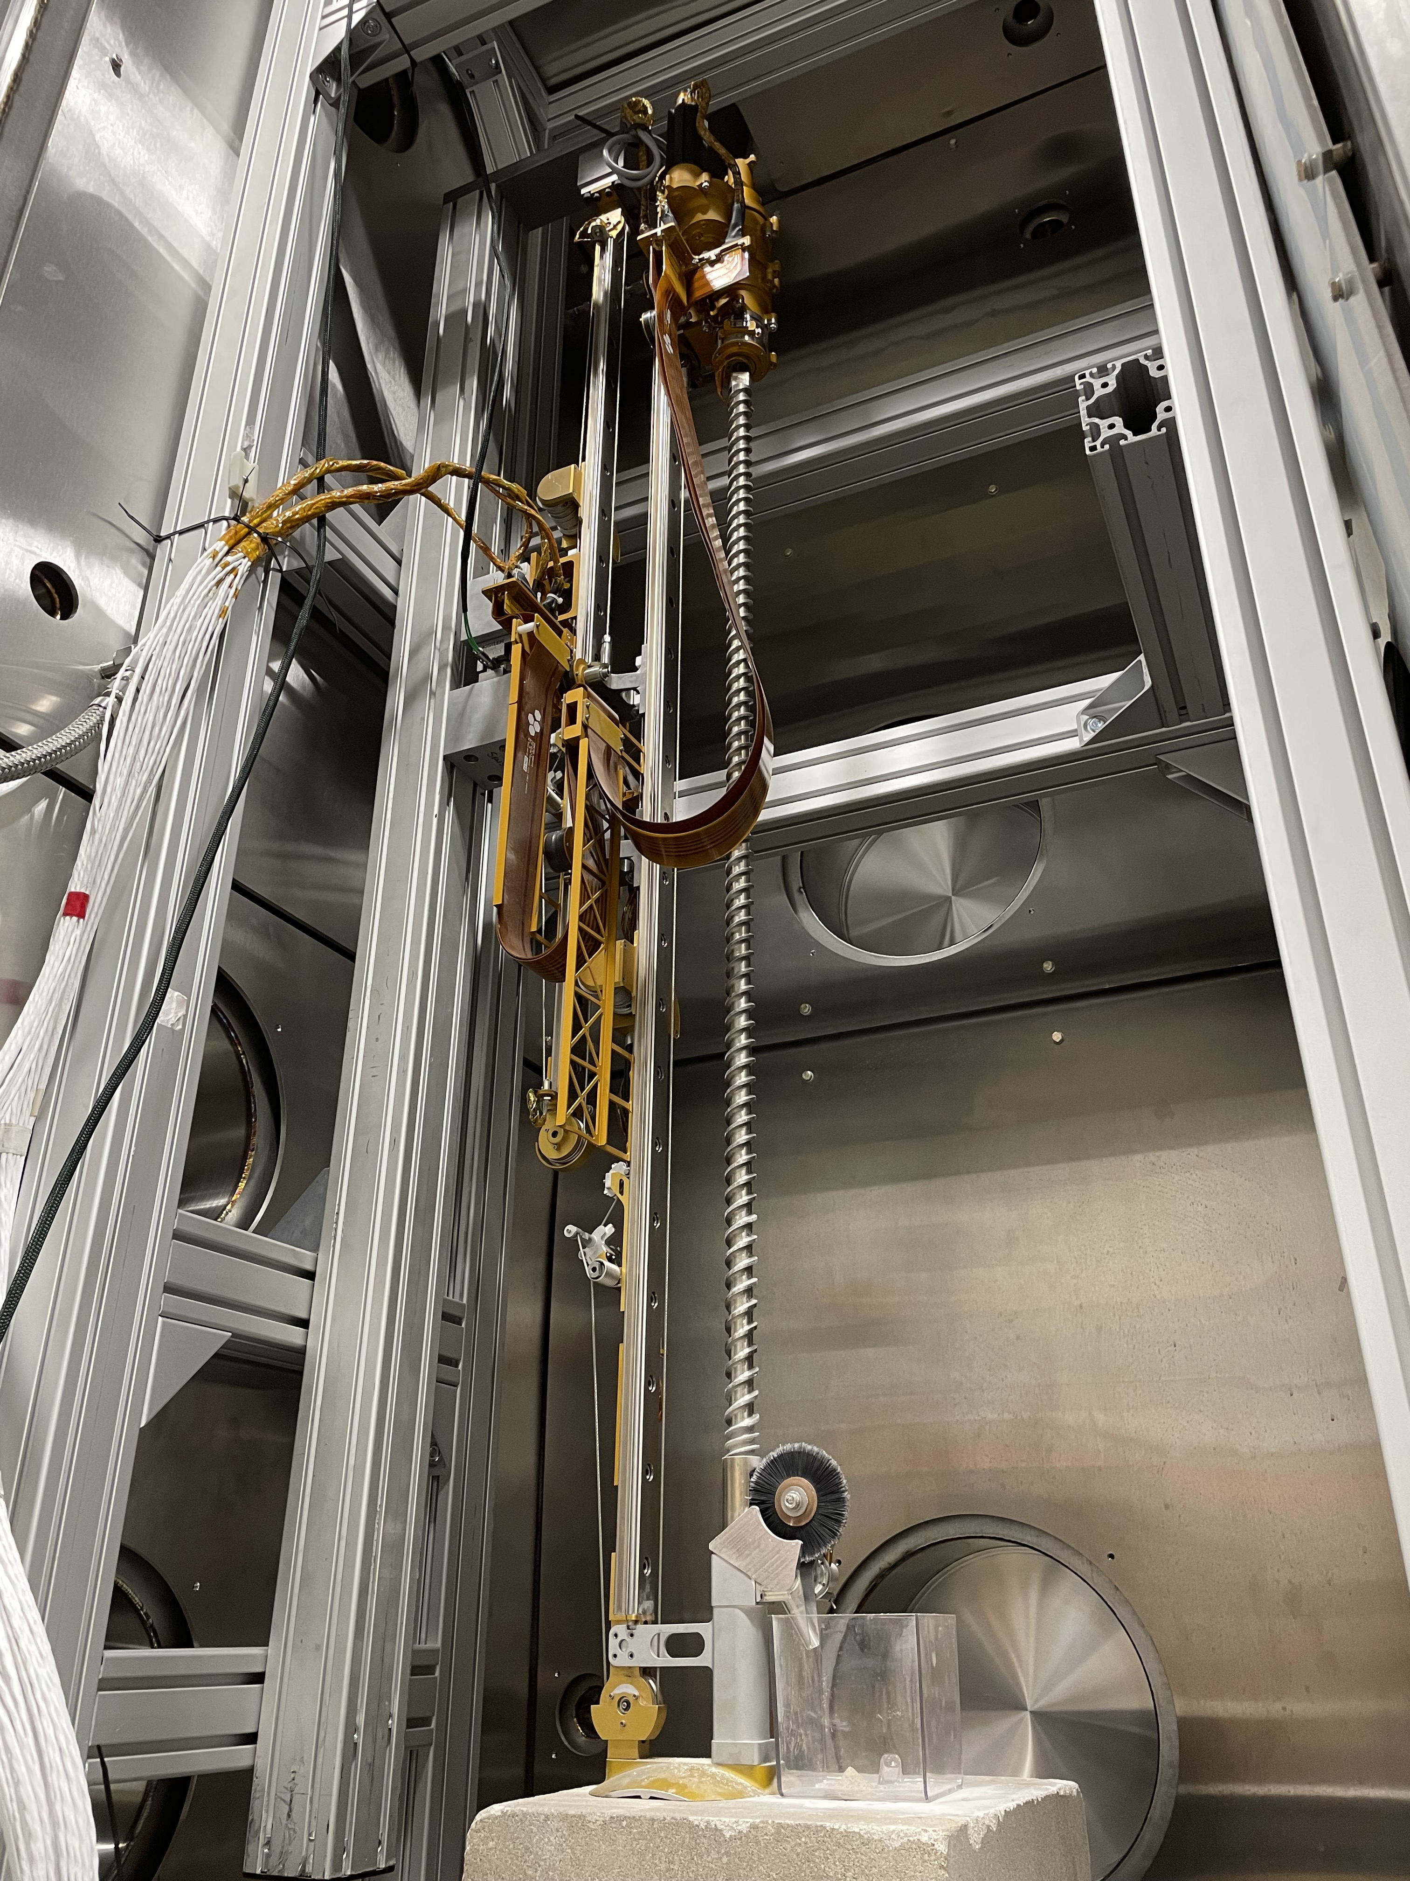
Apollo to Artemis: Drilling on the Moon
Honeybee Robotics
Notes:
-Image credit: Honeybee Robotics → The Regolith and Ice Drill for Exploring New Terrain (TRIDENT) Engineering Development Unit performs testing at Honeybee Robotics.
-50 years ago, Apollo 15 astronauts used the Apollo Lunar Surface Drill to gather geological samples for the first time.
Now, under NASA’s Artemis program, a new drill will be headed to the lunar surface as a commercially delivered payload via the Commercial Lunar Payload Services (CLPS) initiative.
The Regolith and Ice Drill for Exploring New Terrain (TRIDENT) is key to locating ice and other resources on the Moon.
-TRIDENT is a drill on the Polar Resources Ice Mining Experiment-1 (PRIME-1), scheduled to take flight in late 2022.
Designed by Honeybee Robotics to sample lunar regolith (soil), TRIDENT will help understand the physical properties of the lunar regolith while also allowing analysis of the resources present in samples taken from various depths.
One major difference between TRIDENT and its Apollo counterpart is that TRIDENT does not need astronauts to operate it manually.
-The Polar Resources Ice Mining Experiment-1 (PRIME-1) will be the first in-situ resource utilization demonstration on the Moon.
For the first time, NASA will robotically sample and analyze for ice from below the surface. PRIME-1 will use TRIDENT to drill in a single location at a site with a high likelihood of having water – whether in liquid or ice form. It will drill down about 3 feet (1 meter) below the surface, each time bringing up samples that NASA will analyze with a scientific instrument – the Mass Spectrometer observing lunar operations (MSolo).
-What PRIME-1 discovers will help to update resource models for where explorers are most likely to find water on the Moon.
-More info: https://www.nasa.gov/feature/apollo-to-artemis-drilling-on-the-moon/

Slide 18

VIPER Mission
Notes:
-Image credit: NASA’s Scientific Visualization Studio
-In 2023, NASA’s Volatiles Investigating Polar Exploration Rover (VIPER) will land near the western edge of Nobile crater at the Moon’s South Pole to map and explore the region’s surface and subsurface for water and other resources.
This is NASA’s first mobile robotic mission to the Moon.
-Part of the Artemis program, VIPER will launch on a SpaceX Falcon-Heavy rocket for delivery to the Moon by Astrobotic’s Griffin lander under NASA’s Commercial Lunar Payload Services (CLPS) initiative.
-The Moon’s South Pole is one of the coldest areas in our solar system. No prior missions to the Moon’s surface have explored it – scientists have thus far only studied the region using remote sensing instruments, including those on NASA’s Lunar Reconnaissance Orbiter (LRO) and the Lunar Crater Observation and Sensing Satellite (LCROSS). Data from these and other missions helped scientists conclude that ice and other potential resources exist in permanently shadowed areas of the Moon near the poles.
-After an extensive landing site selection process, on September 20, 2021, the mountainous area west of Nobile crater was announced as VIPER’s landing site due to its rover-accessible terrain and array of nearby sites of scientific interest, including permanently shadowed areas.
Nobile crater is an impact crater that was formed through a collision with another smaller celestial body, and is almost permanently covered in shadows, allowing ice to exist there. Smaller, more accessible craters surrounding Nobile’s perimeter, will also provide VIPER with ideal locations to investigate in its search for ice and other resources.
-More info: https://www.nasa.gov/press-release/nasa-s-artemis-rover-to-land-near-nobile-region-of-moon-s-south-pole
-Learn more about VIPER: https://www.nasa.gov/viper

Slide 19
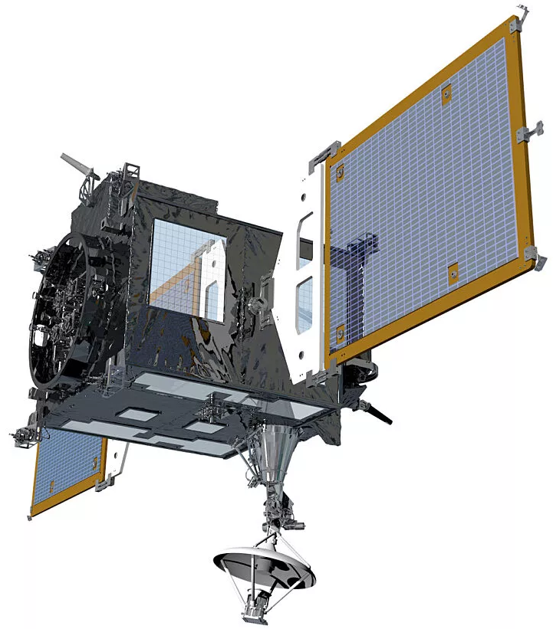
Korea Pathfinder Lunar Orbiter
Korea Aerospace Research Institute
Notes:
-Image credit: Korea Aerospace Research Institute (KARI) → A rendering of the Korea Pathfinder Lunar Orbiter (KPLO).
-The Korea Pathfinder Lunar Orbiter (KPLO) is South Korea’s first lunar mission, and it will be equipped with five payloads developed in Korea and one payload developed by NASA.
It is developed and managed by the Korea Aerospace Research Institute (KARI) and is scheduled to launch in August 2022 from Cape Canaveral, Florida.
It is expected to orbit the Moon for one year.
The goals of the mission are to develop indigenous lunar exploration technologies, demonstrate a “space internet,” and conduct scientific investigations of the lunar environment, topography, and resources, as well as identify potential landing sites for future missions.
-Mission website: https://www.kari.re.kr/eng/sub03_04_01.do
-More info: https://nssdc.gsfc.nasa.gov/nmc/spacecraft/display.action?id=KPLO

Slide 20
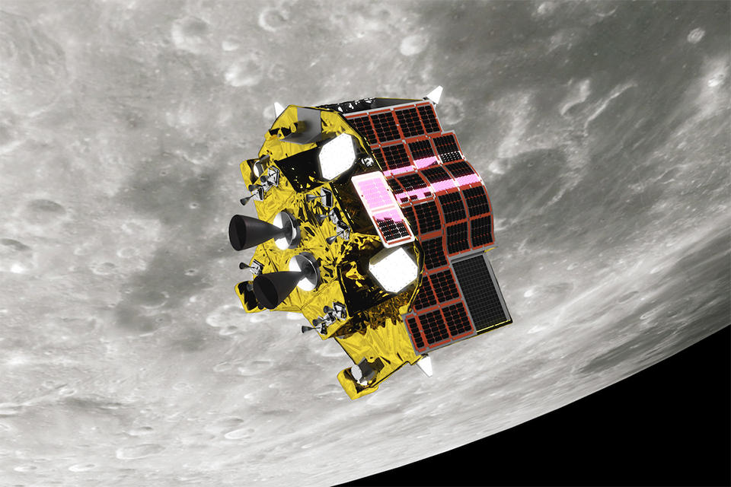
Smart Lander for Investigating Moon (Japan Aerospace Exploration Agency)
JAXA/ISAS
Notes:
-Image credit: JAXA/ISAS → A representation of the Smart Lander for Investigating Moon (SLIM) probe.
-The Smart Lander for Investigating Moon (SLIM) is a Japan Aerospace Exploration Agency (JAXA) mission designed to demonstrate accurate lunar landing techniques by a small spacecraft.
SLIM is a mission for researching the pinpoint landing technology (landing accuracy within 100 m) necessary for future lunar probes and verifying this on the surface of the Moon with a small-scale probe (2.4 m by 2.7 m by 1.7 m).
High accuracy landings near specific targets of study have become highly desired, and the SLIM lander would allow humans to make a qualitative shift towards being able to land where we’d like to and not just where it is easy, as has typically been the case.
-SLIM is scheduled to launch as a “ride-share” payload with the X-Ray Imaging and Spectroscopy Mission (XRISM) in 2022 from the Tanegashima Space Center in Japan.
-More info: https://global.jaxa.jp/projects/sas/slim/

